Slide 1
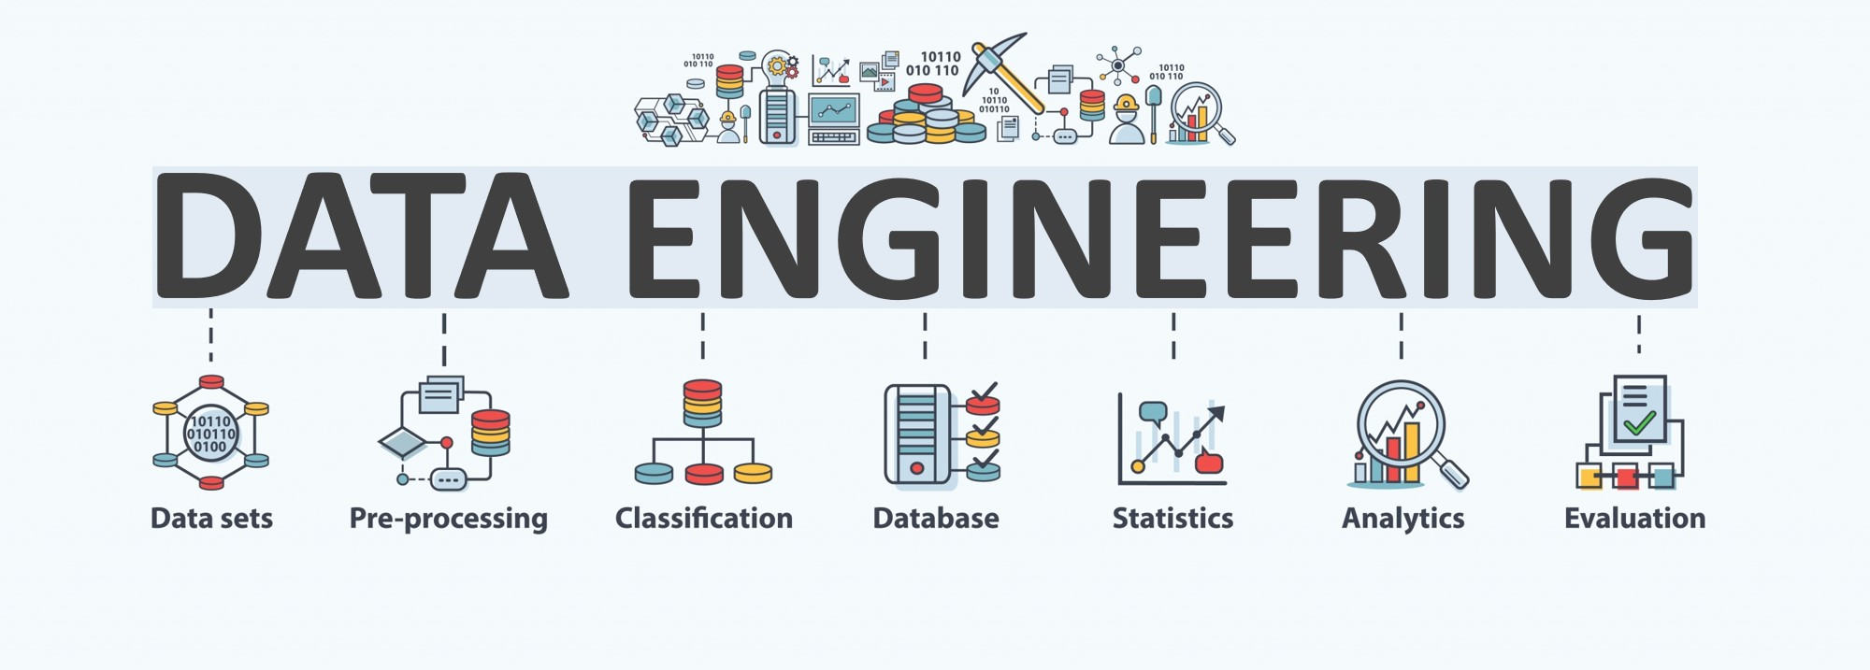

Lecture 2: Data Acquisition
CS5481 Data Engineering
Instructor: Yifan Zhang

Slide 2
Outline
1. Data sources
2. Web scraping
3. From web scraping to web crawling

Slide 3
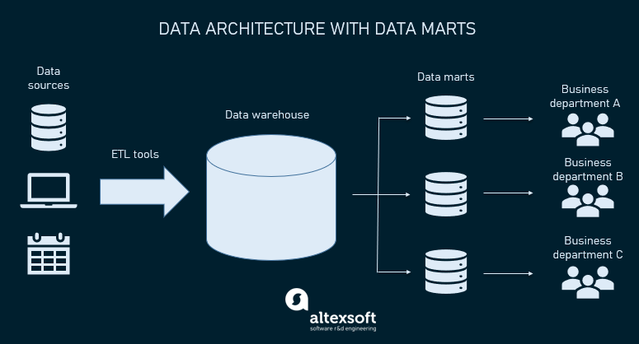
Sources of data
Relational databases
Flat files and XML datasets
APIs and web services
Notes:
https://www.altexsoft.com/blog/datascience/what-is-data-engineering-explaining-data-pipeline-data-warehouse-and-data-engineer-role/

Slide 4
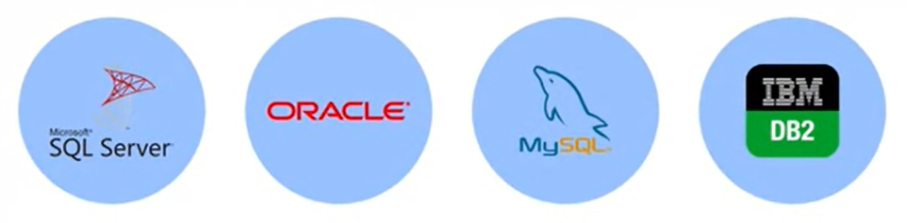
Relational databases
Typically, data stored in databases and data warehouses can be used as a source for analysis, organizations have internal applications to support them in managing:
Day to day business activities
Customer transactions
Human resource activities
Workflows
Notes:
https://www.altexsoft.com/blog/datascience/what-is-data-engineering-explaining-data-pipeline-data-warehouse-and-data-engineer-role/

Slide 5
Relational databases (examples)
Day to day business activities
Retail: A clothing store uses a database to track inventory levels, ensuring they don't run out of stock. For example, a system records that a size M red t-shirt is sold, and it updates the inventory in real time. A relational database might have:
A Products table: ProductID, Name, Category, Price, Stock.
A Sales table: SaleID, ProductID, Date, Quantity.
When a sale occurs, the system links the ProductID in the Sales table to the corresponding entry in the Products table to update the stock.

Slide 6
Relational databases (examples)
Customer transactions
E-commerce: When a customer places an order on an online shopping platform, the system records the details (items purchased, payment method, and shipping address) in a database. Relational databases excel in organizing transactional data:
A Customers table: CustomerID, Name, Email, Phone.
An Orders table: OrderID, CustomerID, Date, TotalAmount.
An OrderDetails table: OrderDetailID, OrderID, ProductID, Quantity, Price.
By linking these tables, the database ensures seamless tracking of customer orders and inventory updates.
Notes:
https://www.altexsoft.com/blog/datascience/what-is-data-engineering-explaining-data-pipeline-data-warehouse-and-data-engineer-role/

Slide 7
Relational databases (examples)
Human resource activities
Recruitment: Companies maintain databases of job applicants, including their resumes, interview statuses, and feedback. Relational databases maintain recruitment data with clear relationships:
Applicants table: ApplicantID, Name, Email, Phone.
JobPositions table: PositionID, Title, Department, SalaryRange.
Applications table: ApplicationID, ApplicantID, PositionID, Status.
Relationships track which applicant applied to which position and their current application status.

Slide 8
Relational databases (examples)
Workflows
Manufacturing: Factories use databases to schedule and monitor production tasks, such as tracking which machines are in use and when maintenance is due. Workflows are often tracked with relational tables linking tasks, resources, and schedules:
Projects: ProjectID, Name, StartDate, EndDate.
Tasks: TaskID, ProjectID, AssigneeID, Status.
Employees: EmployeeID, Name, Role.
Links ensure task assignments are clear and progress is updated in real time.

Slide 9
Using queries to extract data from relational databases
SQL, or Structured Query Languages, is a querying language used for extracting information form relational databases. Offers simple commands to specify:
What is to be retrieved from the database.
Table from which it needs to be extracted.
Grouping records with matching values.
Dictating the sequence in which the query results are displayed.
Limiting the number of results that can be returned by the query.
Notes:
https://www.globalpatron.com/blog/data-collection-methods/
https://flowheater.net/en/

Slide 10
Relational databases (examples)
Customer transactions
E-commerce: When a customer places an order on an online shopping platform, the system records the details (items purchased, payment method, and shipping address) in a database. Relational databases excel in organizing transactional data:
A Customers table: CustomerID, Name, Email, Phone.
An Orders table: OrderID, CustomerID, Date, TotalAmount.
An OrderDetails table: OrderDetailID, OrderID, ProductID, Quantity, Price.
By linking these tables, the database ensures seamless tracking of customer orders and inventory updates.
Notes:
https://www.altexsoft.com/blog/datascience/what-is-data-engineering-explaining-data-pipeline-data-warehouse-and-data-engineer-role/

Slide 11
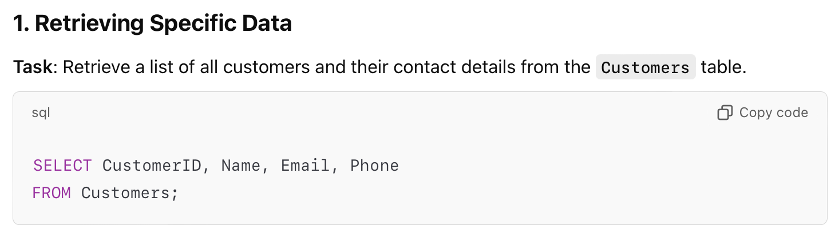
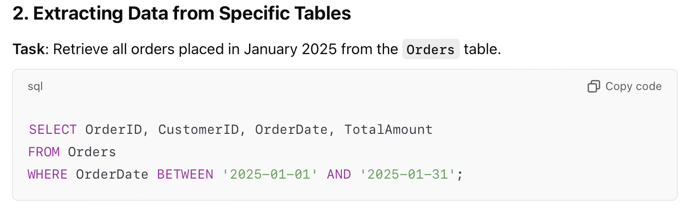
Using queries to extract data from relational databases (examples)
Notes:
https://www.globalpatron.com/blog/data-collection-methods/
https://flowheater.net/en/

Slide 12
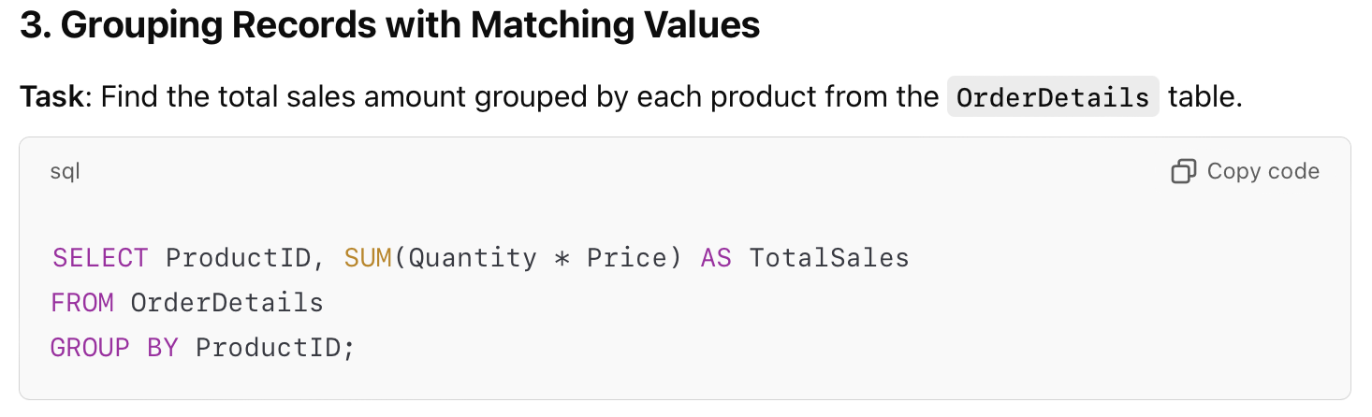
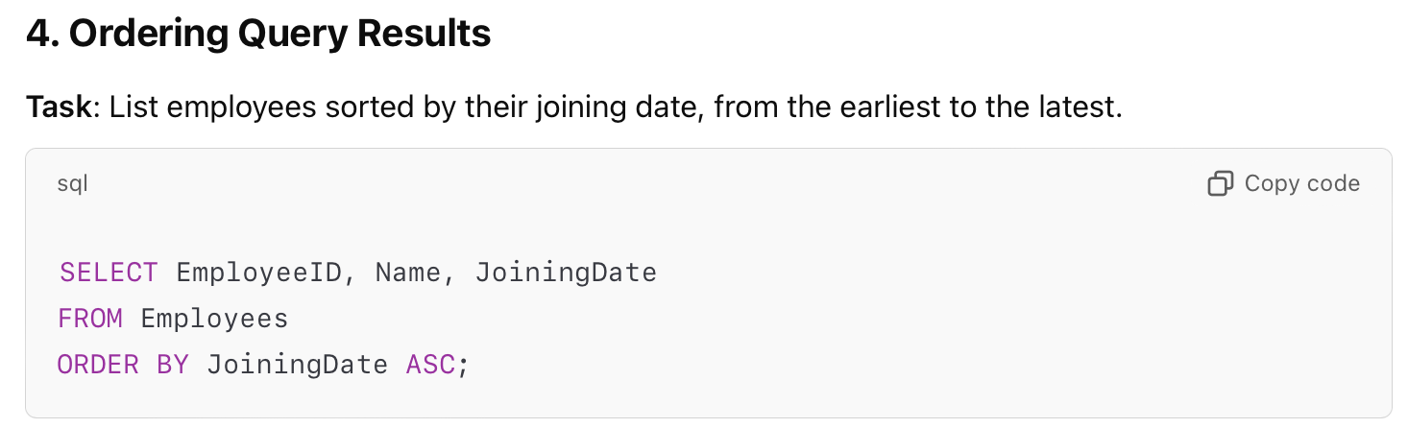
Using queries to extract data from relational databases (examples)
Notes:
https://www.globalpatron.com/blog/data-collection-methods/
https://flowheater.net/en/

Slide 13
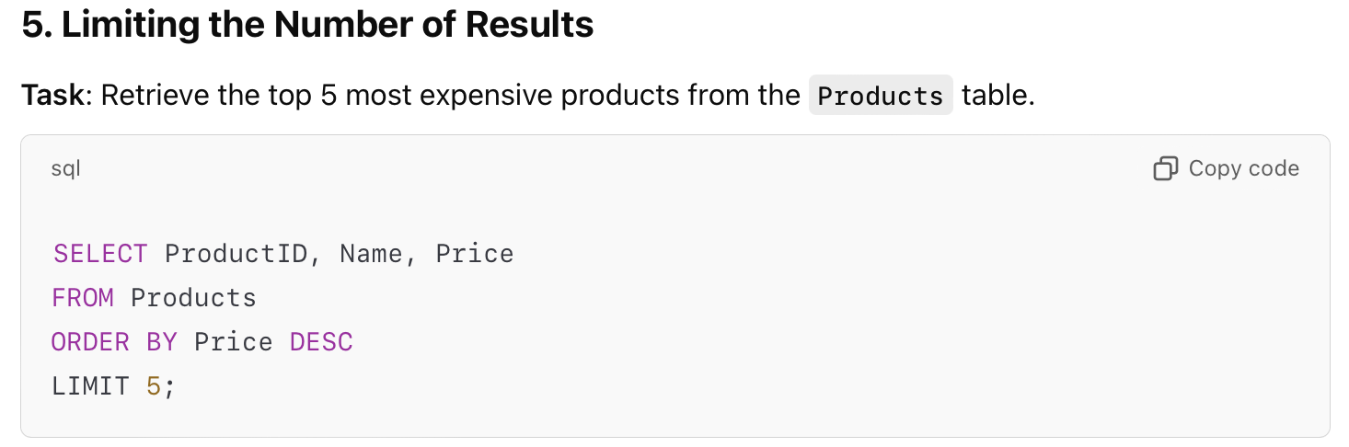
Using queries to extract data from relational databases (examples)
Notes:
https://www.globalpatron.com/blog/data-collection-methods/
https://flowheater.net/en/

Slide 14
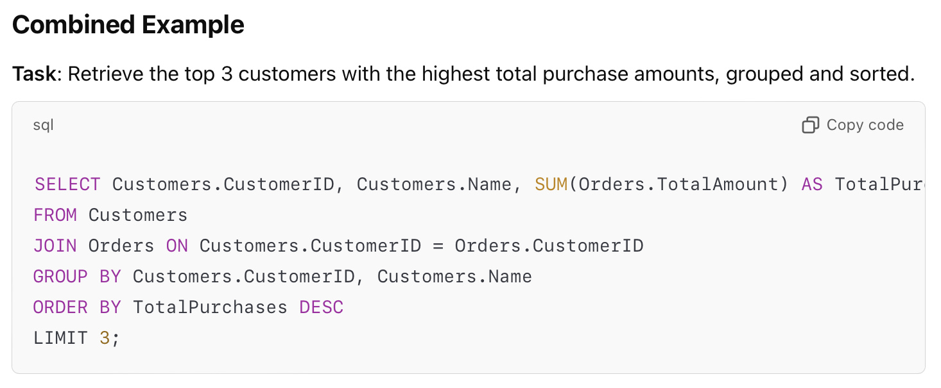
Using queries to extract data from relational databases (examples)
Notes:
https://www.globalpatron.com/blog/data-collection-methods/
https://flowheater.net/en/

Slide 15



Using queries to extract data from non-relational databases
Non-relational databases can be queried using SQL or SQL-like query tools.
Some non-relational databases come with their own querying tools such as CQL for Cassandra and GraphQL for Neo4J.

Slide 16
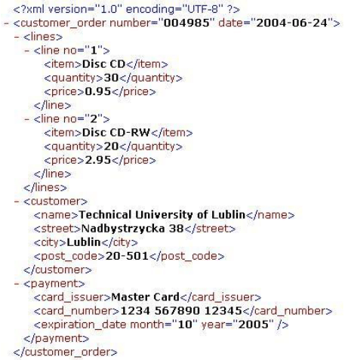
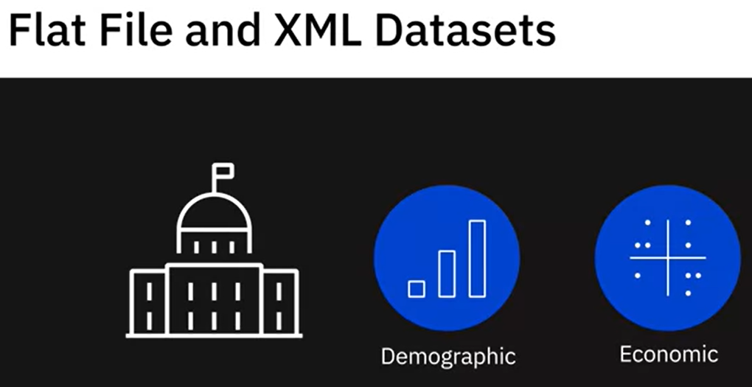
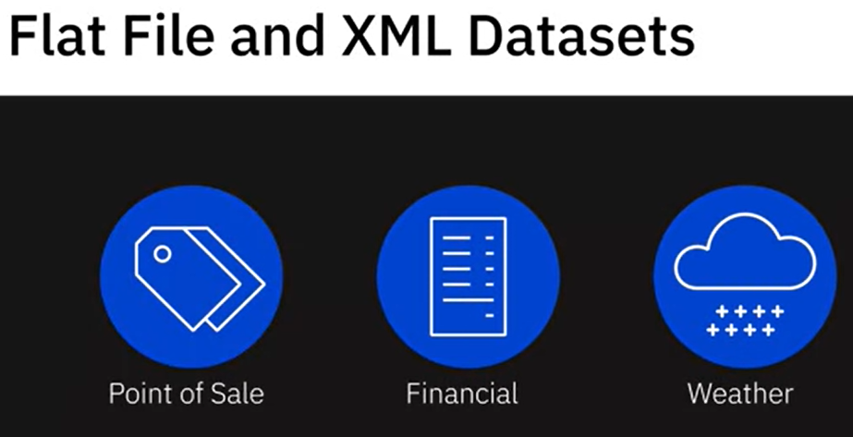
Flat file and XML datasets
External to the organization, there are other publicly and privately available datasets.
Such data sets are typically made available as flat files, spreadsheet files, or XML documents.
Notes:
For example, government organizations releasing demographic and economic datasets on an ongoing basis. Then there are companies that sell specific data, for example, Point-of-Sale data or Financial data, or Weather data, which businesses can use to define strategy, predict demand, and make decisions related to distribution or marketing promotions, among other things.
https://www.altexsoft.com/blog/datascience/what-is-data-engineering-explaining-data-pipeline-data-warehouse-and-data-engineer-role/

Slide 17
Flat files
Store data in plain text format
Each line, or row, is one record
Each value is separated by a delimiter
All of the data in a flat file maps to a single table
Most common flat file format is .CSV
Notes:
For example, government organizations releasing demographic and economic datasets on an ongoing basis. Then there are companies that sell specific data, for example, Point-of-Sale data or Financial data, or Weather data, which businesses can use to define strategy, predict demand, and make decisions related to distribution or marketing promotions, among other things.
https://www.altexsoft.com/blog/datascience/what-is-data-engineering-explaining-data-pipeline-data-warehouse-and-data-engineer-role/

Slide 18
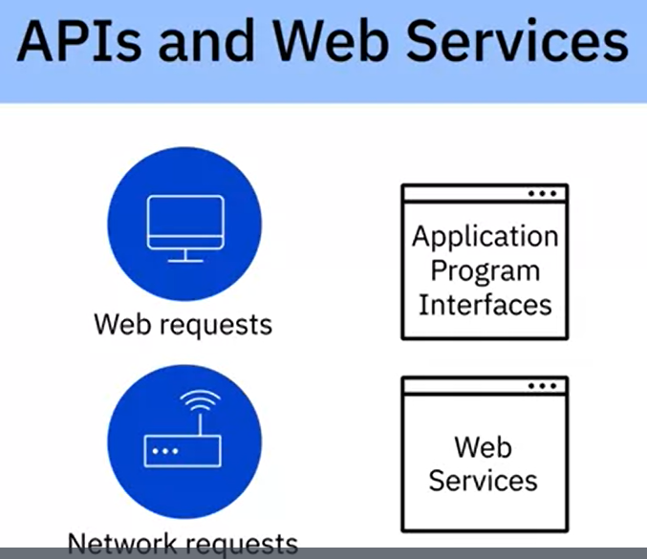
APIs and web services
APIs and Web Services typically listen for incoming requests, which can be in the form of web requests from users or network requests from applications, and return data in plain text, XML, HTML, JSON, or media files.
Web Requests
Network Requests

Slide 19
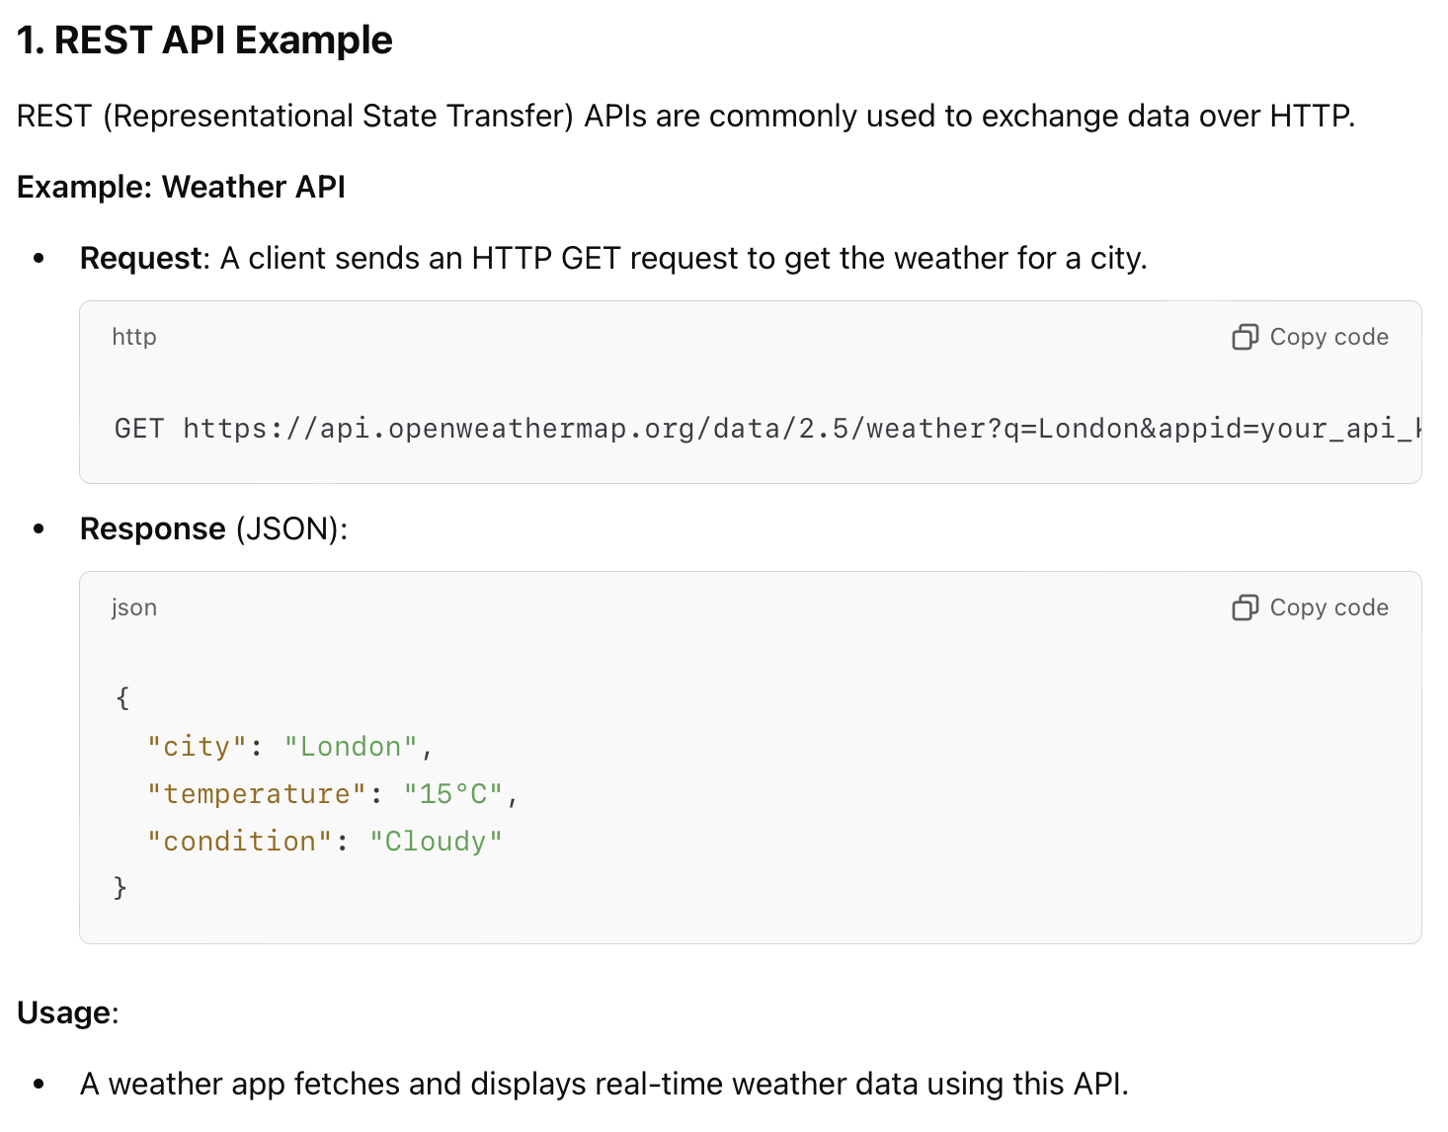
APIs and web services (examples)

Slide 20
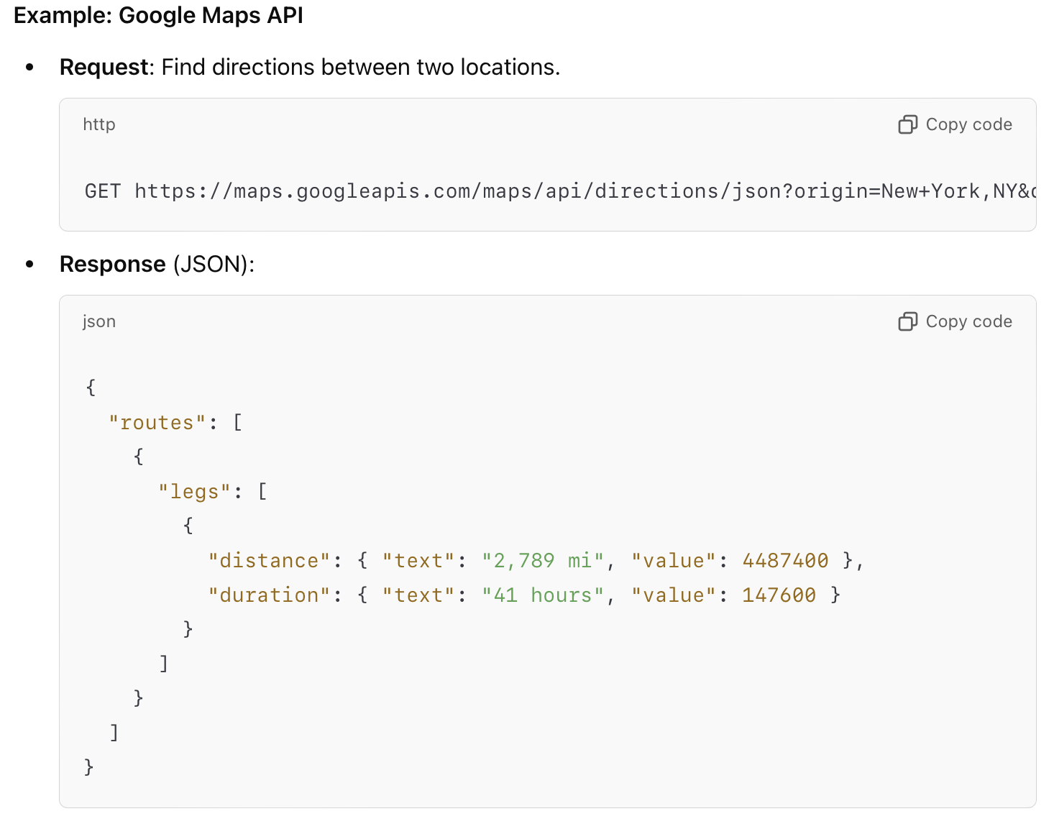
APIs and web services (examples)

Slide 21

Sources for gathering data – web
Web is a source of publicly available data that is available to companies and individuals for free or commercial use.
News websites, social networks
Textbooks
Government records
Papers and articles for public consumption
Notes:
https://www.tableau.com/solutions/web-data-sources

Slide 22
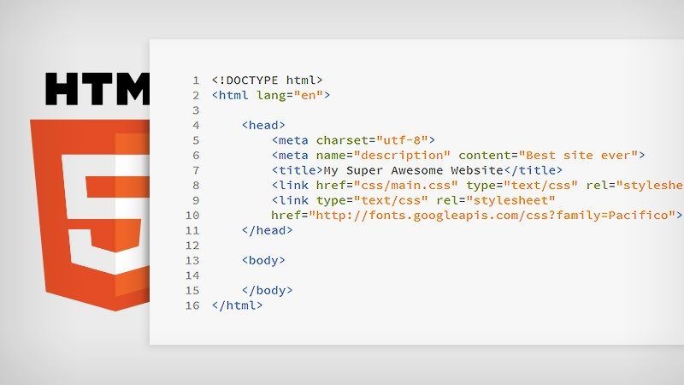
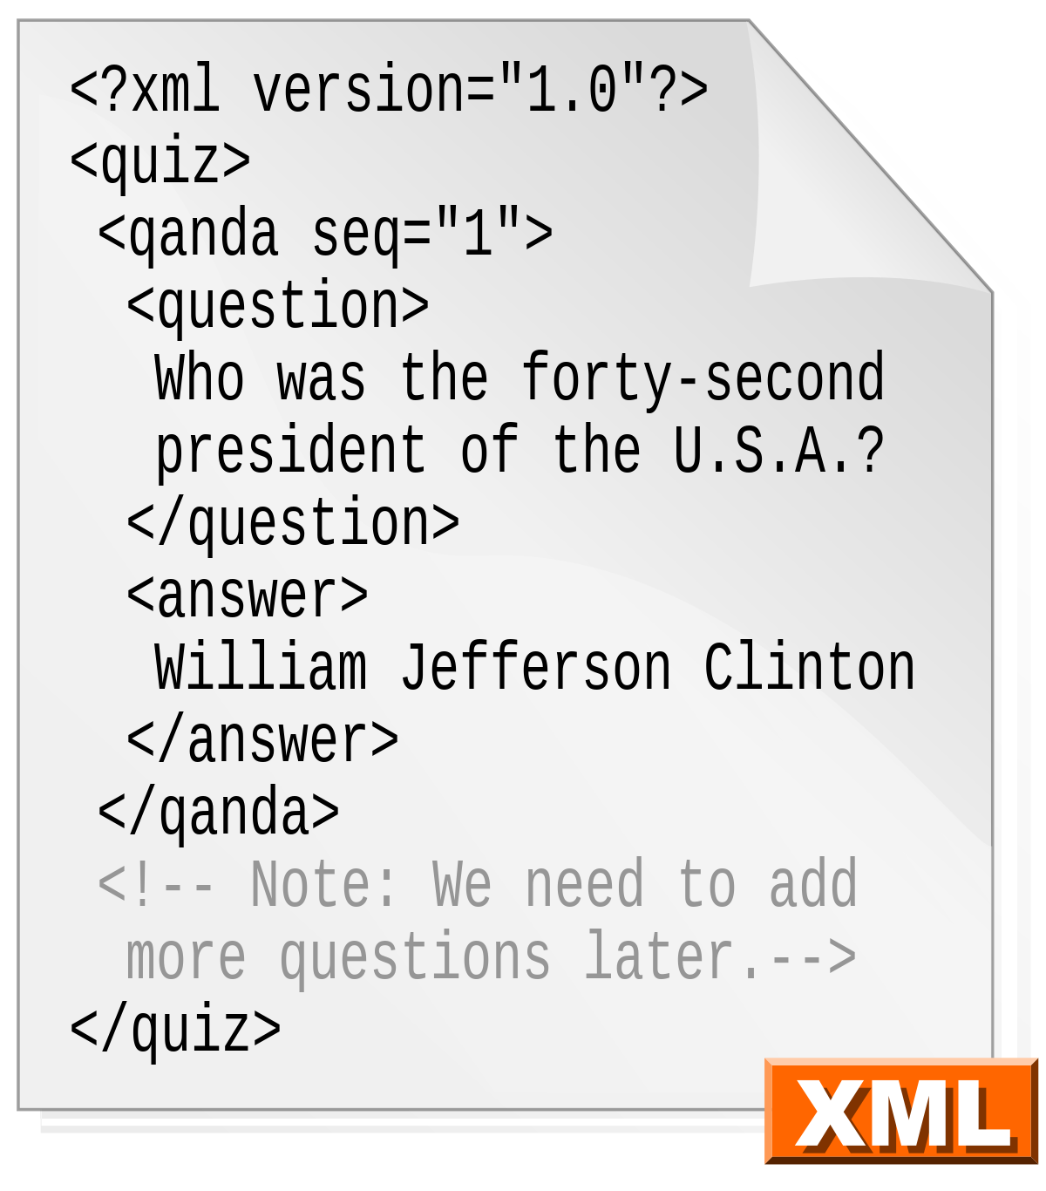
Types of file formats (1)
Delimited text file formats, or .CSV
used to store data as text, each value is separated by a delimiter.
Microsoft Excel Open .XML Spreadsheet, or .XLSX
The HyperText Markup Language (HTML) is the standard markup language for documents designed to be displayed in a web browser.
Extensible Markup Language, or .XML
It is a markup language with set rules for encoding data.
Notes:
https://es.wikipedia.org/wiki/Extensible_Markup_Language

Slide 23
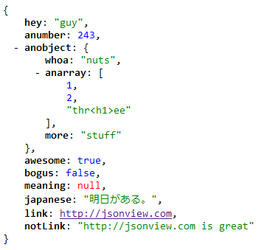
Types of file formats (2)
Portable Document Format, or .PDF
Can be viewed the same way on any device.
JavaScript Object Notation, or .JSON
A text-based open standard designed for transmitting structured data over the web.
Notes:
https://addons.mozilla.org/en-US/firefox/addon/jsonview/

Slide 24
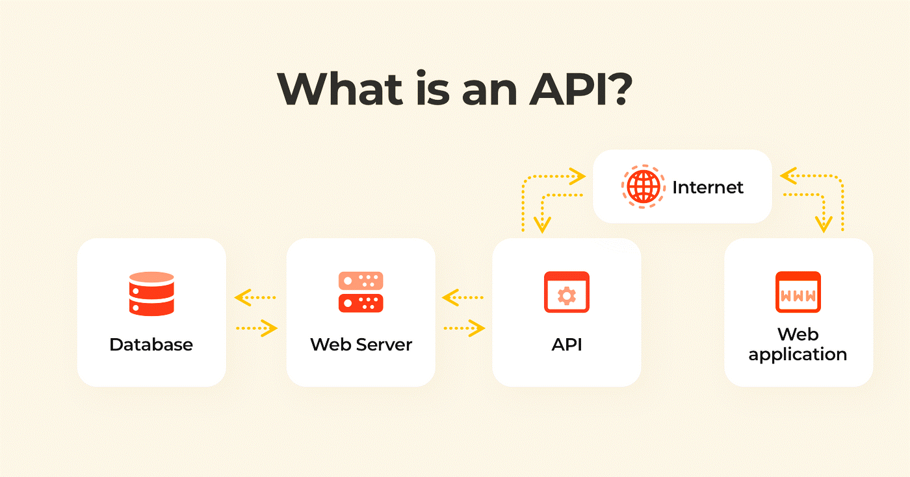
Application Programming Interfaces (or APIs)
Popularly used for extracting data from a variety of data sources.
Are invoked form applications that require the data and access an endpoint containing the data. Endpoints can include databases, web services, and data marketplaces.
Also used for data validation.
Notes:
https://www.cleveroad.com/blog/what-is-an-api/

Slide 25




API examples
Popular Examples of APIs
Twitter and Facebook APIs
For customer sentiment analysis
Stock market APIs
For trading and analysis
Data lookup and validation APIs
For cleaning and co-relating data
Notes:
https://www.flaticon.com/free-icon/stock-market_4222002
https://www.iconfinder.com/icons/440834/search_find_research_search_data_database_explore_lookup_icon

Slide 26
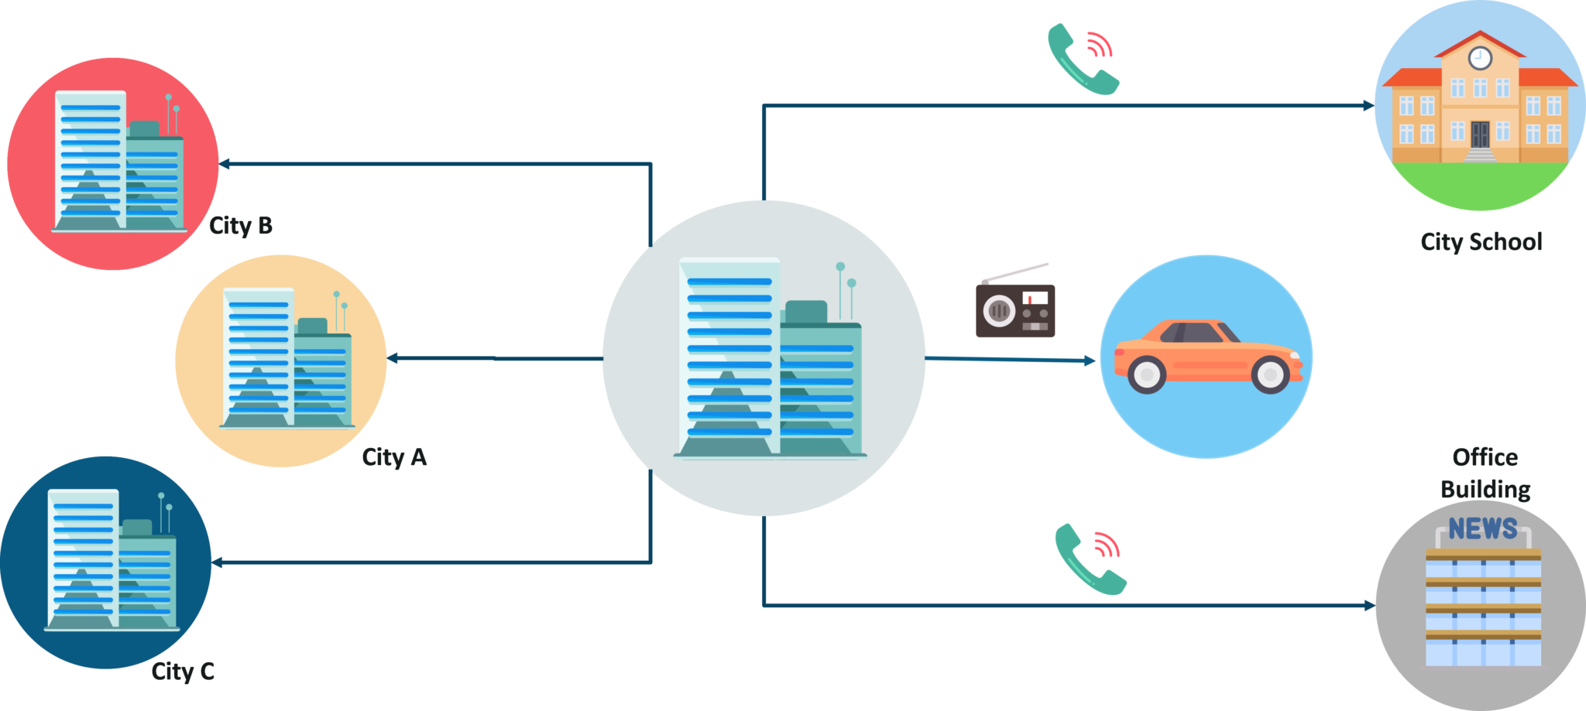
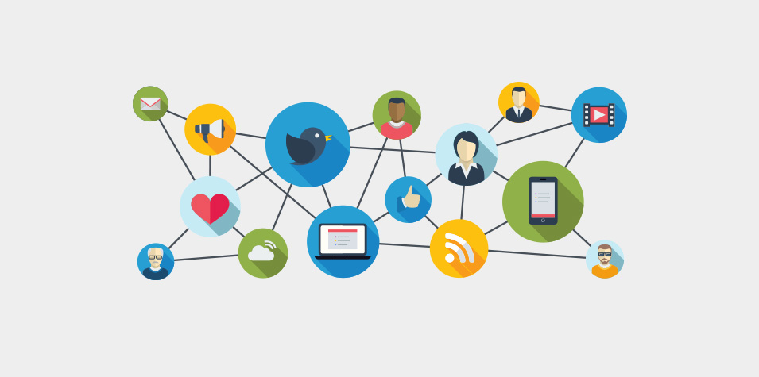
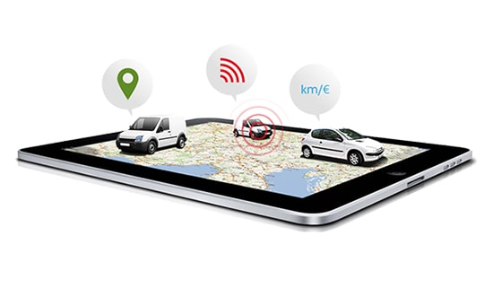
Data streams and feeds
Aggregating streams of data flowing from:
Instruments
IoT devices and applications
GPS data from cars
Computer programs
Websites
Social network.
On the World Wide Web, a web feed is a data format used for providing users with frequently updated content.

Slide 27
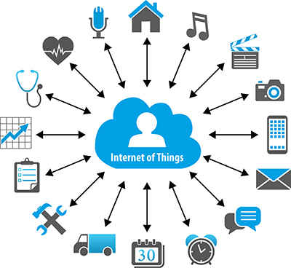
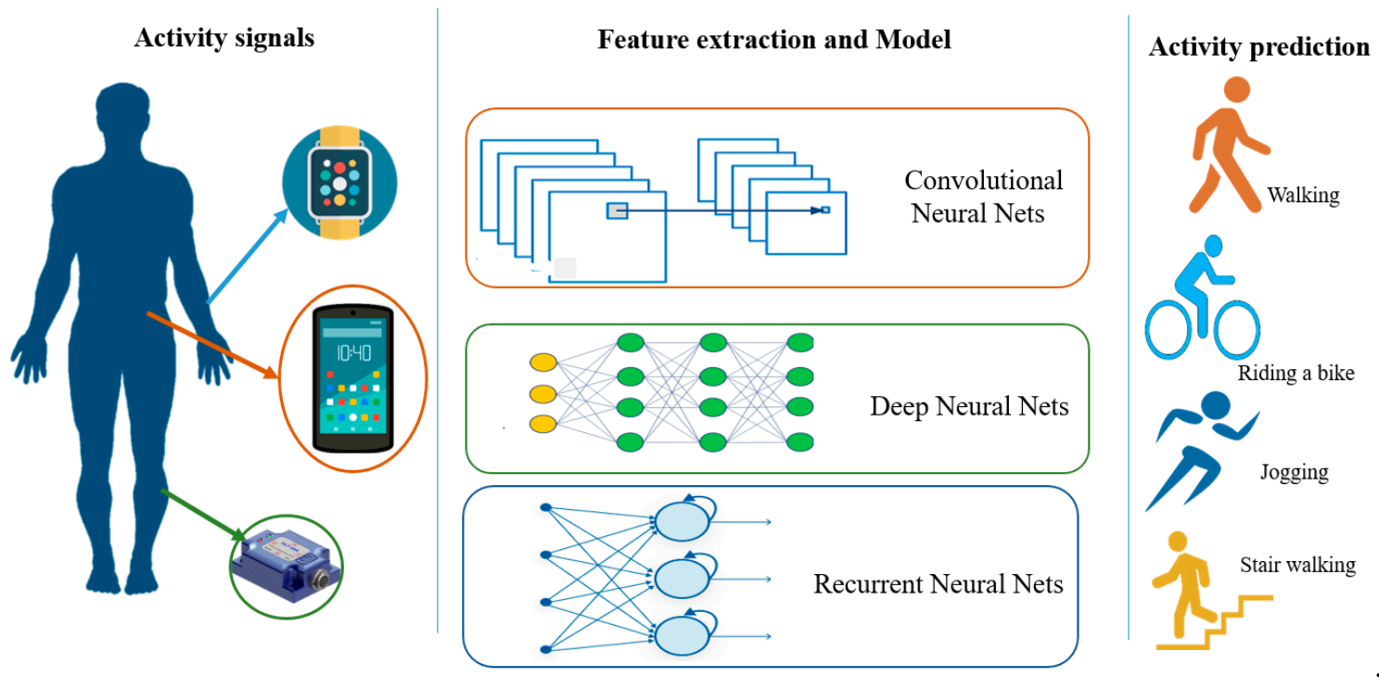
Sources for gathering data – sensor data
Sensor data produced by wearable devices, smart buildings, smart cities, smartphones, medical devices, even household appliances, is a widely used source of data.
Notes:
https://www.mdpi.com/1424-8220/21/
https://www.evelta.com/blog/iot-sensors/8/2814/htm

Slide 28
Data streams and feeds examples
Examples of uses:
Surveillance and video feeds for threat detection.
Sensor data feeds for monitoring industrial or framing machinery.
Social media feeds for sentiment analysis.
Stock and market tickers for financial trading.
Retail transaction streams for predicting demand and supply chain management.
Web click feeds for monitoring web performance and improving design.

Slide 29


Data streams and feeds tools
Popular technologies used to process data streams include:
Kafka
Storm
Apache Kafka is a distributed event store and stream-processing platform. It is an open-source system developed by the Apache Software Foundation written in Java and Scala. The project aims to provide a unified, high-throughput, low-latency platform for handling real-time data feeds
Apache Storm is a distributed stream processing computation framework written predominantly in the Clojure programming language.

Slide 30




Sources for gathering data – data exchange
Data exchange is a source of third-party data that involves the voluntary sharing of data between data providers and data consumers. Individuals, organizations, and governments could be both data providers and data consumers.
Data from business applications
Sensor devices
Social media activity
Location data
Consumer behavior data
AWS DataExchange
Crunchbase
Lotame
Snowflake
Notes:
https://www.novinite.com/articles/215124/Seven+Countries+are+setting+up+a+Data+Exchange+System+closed+to+China+and+Russia

Slide 31
Other sources for gathering data
Surveys – gather information through questionnaires distributed to a select group of people.
Census – popularly used for gathering household data such as wealth and income of population.
Interviews – a source for gathering qualitative data such as the participant’s opinions and experiences. Interviews can be telephonic, over the web, or face-to-face.
Observation studies – include monitoring participants in a specific environment or while performing a particular task.
Notes:
https://www.novinite.com/articles/215124/Seven+Countries+are+setting+up+a+Data+Exchange+System+closed+to+China+and+Russia

Slide 32
Outline
1. Data sources
2. Web scraping
3. From web scraping to web crawling

Slide 33
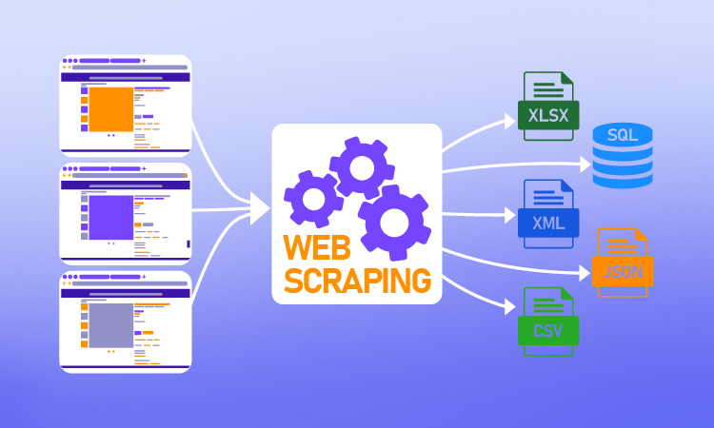
Web scraping
The construction of an agent to download, parse, and organize data from the web in an automated manner
Extract relevant data from unstructured sources on the Internet
Also known as screen scraping, web harvesting, and web data extraction
Can extract text, contact information, images, videos, product items, etc.

Slide 34
Web scraping examples
Popular examples of uses:
Generating sales leads through public data sources; weather information to forecast, for example, soft drink sales.
Collecting training and testing datasets for machine learning models.
There might be an interesting table on a Wikipedia page (or pages) you want to retrieve to perform some statistical analysis.
You might wish to get a listing of properties on a real-estate site to build an appealing geo-visualization.

Slide 35




Web scraping tools
Popular Web Scraping tools:
BeautifulSoup
Scrapy
Pandas
Selenium

Slide 36
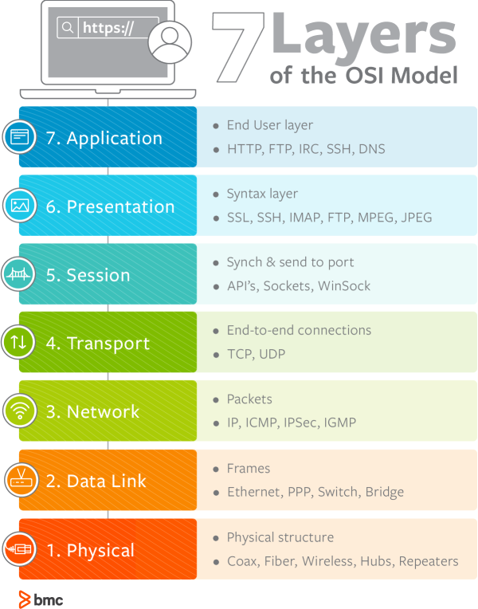
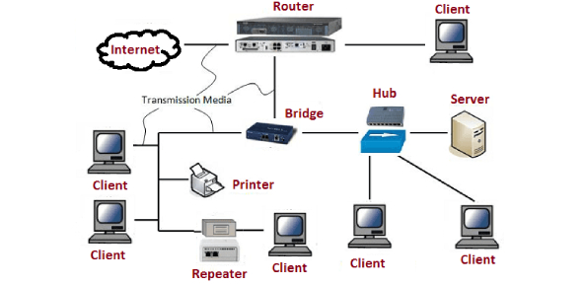
The web speaks HTTP
7 network layers of Open Systems Interconnection (OSI) model
Web scraping mainly focus on the application layer: HTTP

Slide 37
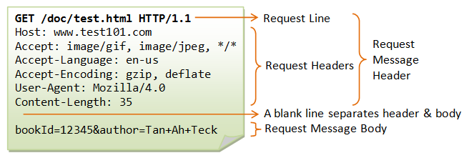
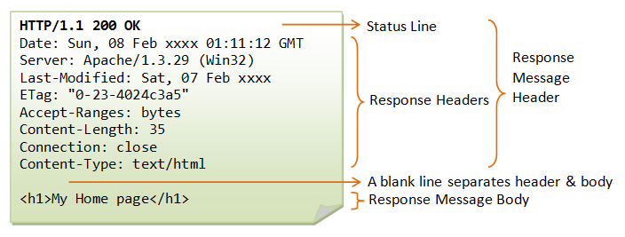
HTTP
The core component in the exchange of messages on WWW consists of a HyperText Transfer Protocol (HTTP) request message to a web server, followed by an HTTP response, which can be rendered by the browser.
Response message body is usually html format

Slide 38
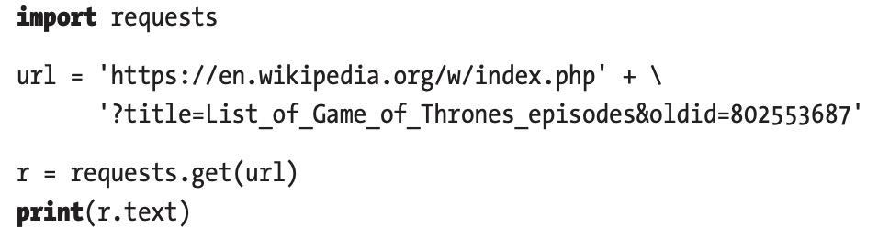
Hypertext Markup Language (HTML)
HTML is a standard markup language for creating web pages.
HTML provides the building blocks to provide structure and formatting to documents.
Python ‘requests’ library could get the html content from a webpage.

Slide 39
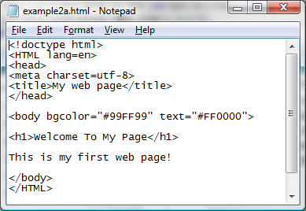
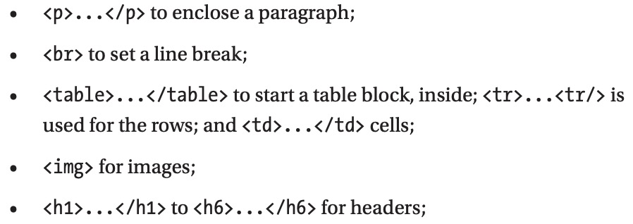
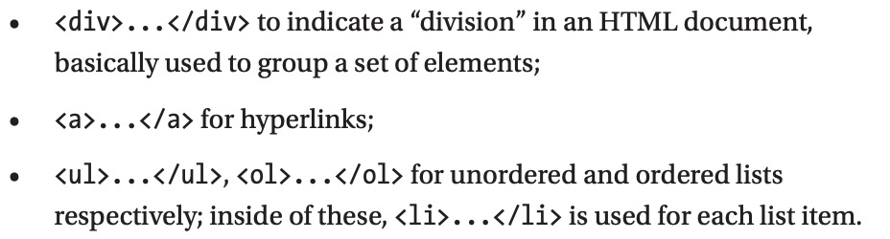
HTML format
HTML’s building blocks are usually a series of tags that often come in pairs (but not always).
Commonly used tags

Slide 40
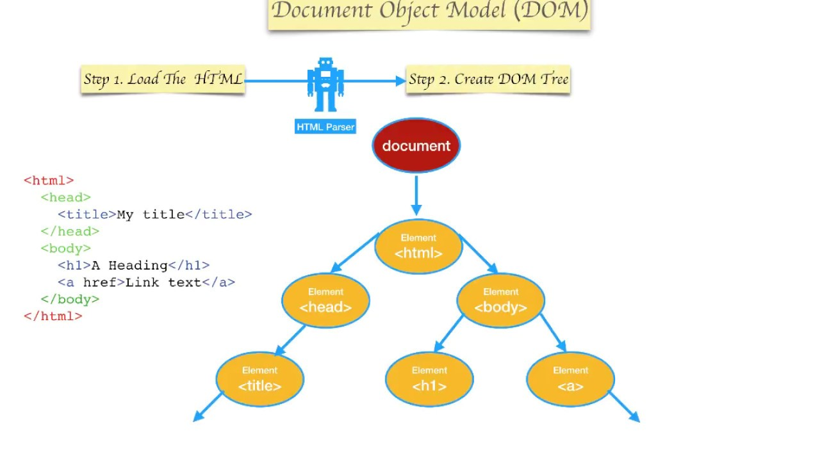
HTML parsing
HTML parsing involves tokenization and tree construction. HTML tokens include start and end tags, as well as attribute names and values. If the document is well-formed, parsing it is straightforward and faster. The parser parses tokenized input into the document, building up the document tree.

Slide 41
General web scraping procedure
Identifying data for scraping
Scraping the data
Importing the data

Slide 42

Identifying data for scraping (1)
Importance of Identifying data for analysis:
Identifying the right data is very important step of the data analysis process.
Done right, it will ensure that your are able to look at a problem from multiple perspectives and your findings are credible and reliable.

Slide 43
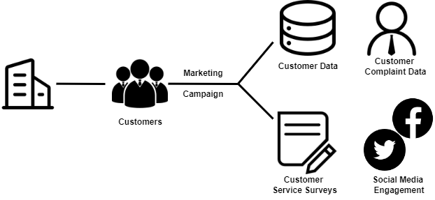
Identifying data for scraping (2)
Process for identifying data
Step 1: Determine the information you want to collect
The specific information you need
The possible sources for this data

Slide 44
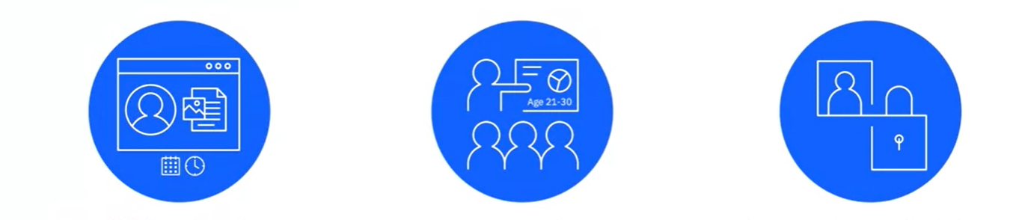
Identifying data for scraping (3)
Process for identifying data
Step 2: Define a plan for collecting data
Establish a timeframe for collecting data
How much data is sufficient for a credible analysis
Define dependencies, risks, and mitigation plan

Slide 45




Identifying data for scraping (4)
Process for identifying data
Step 3: Determine your data collection methods. The methods depend on:
Sources of Data
Type of Data
Timeframe over which you need the data
Volume of data

Slide 46
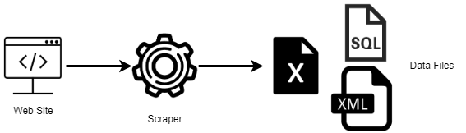
Web scraping
Web Scraping: Extracting a large amount of specific data from online sources

Slide 47
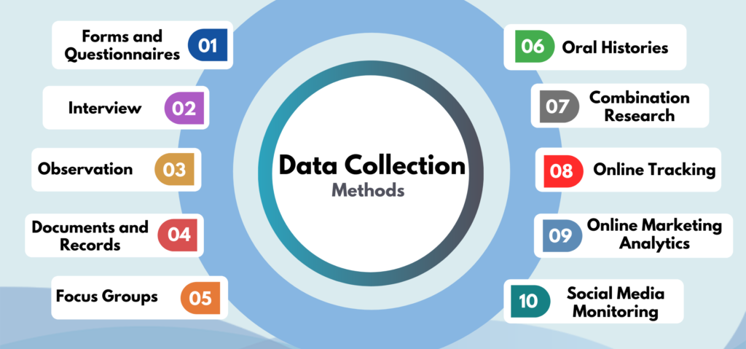
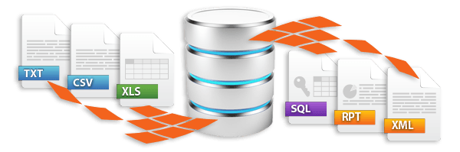
Importing data into data repositories
Gathering data from data sources such as databases, the web, sensor data, data exchanges, and several other sources leveraged for specific data needs.
Importing data into different types of data repositories.
Notes:
https://www.globalpatron.com/blog/data-collection-methods/
https://flowheater.net/en/

Slide 48
Importing structured data
Importing data: data Identified and gathered -> data repository
Specific data repositories are optimized for certain types of data.
Relational databases store structured data with a well-defined schema
Sources include data from OLTP systems, spreadsheets, online forms, sensors, network and web logs.
Can be stored in NoSQL database.
Structured data

Slide 49
Importing unstructured data
Specific data repositories are optimized for certain types of data.
Sources include emails, XML, zipped files, binary executables, and TCP/IP protocols.
Can also be stored in NoSQL clusters.
XML and JSON are commonly used for storing and exchanging semi-structured data.
Semi-structured Data

Slide 50
Outline
1. Data sources
2. Web scraping
3. From web scraping to web crawling

Slide 51
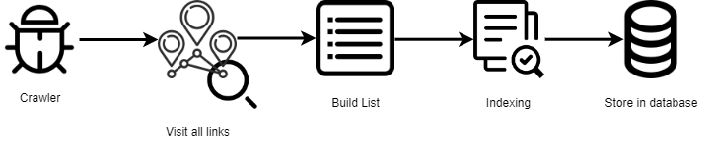
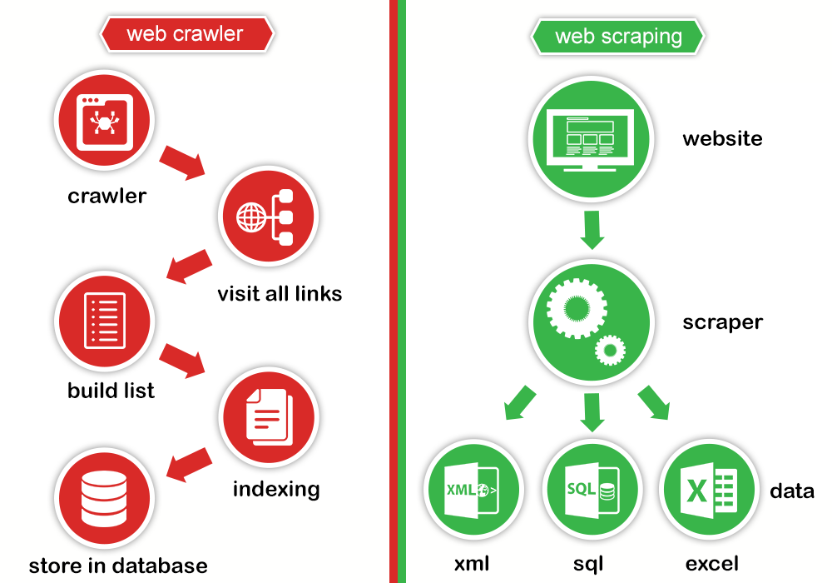
From web scraping to web crawling
Web Crawling: Using tools to read, copy and store the content of the websites for archiving or indexing purposes. Crawling usually deals with a network of webpages
Web Scraping: Extracting a large amount of specific
data usually from a single webpage or a single website

Slide 52
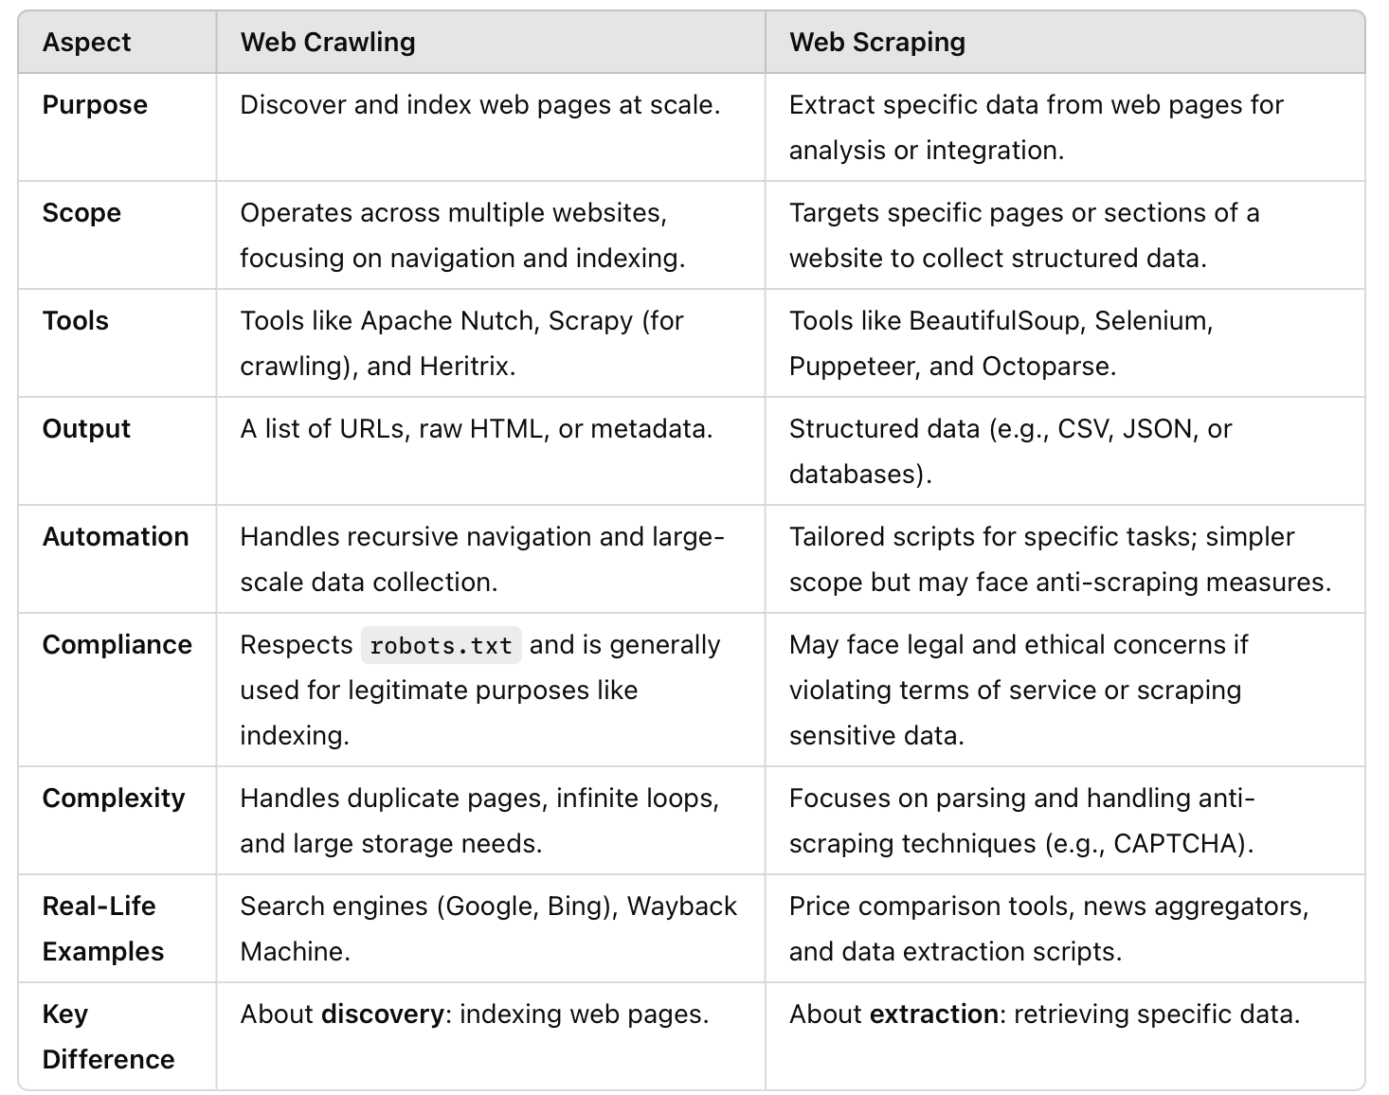
Web scraping VS Web crawling

Slide 53
Different use cases
Web Crawling
Web Scrapers
Generating search engine results.
Monitoring SEO analytics.
Performing website analysis.
Performed only by large corporations.
Comparing prices.
Stock market analysis.
Managing brand reputation.
Academic and scientific research.
Used by small and large businesses

Slide 54

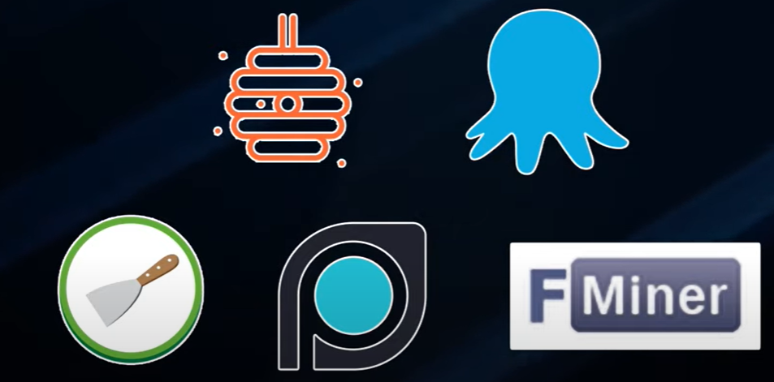
Tools
Differences between Web Crawling and Web Scraping
Web Crawlers
Web Scrapers

Slide 55
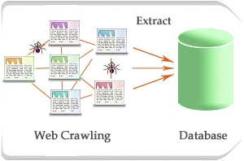
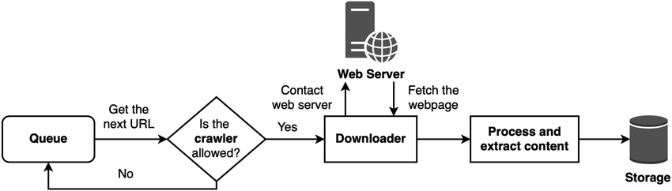
Web crawling process
A web crawler operates like a graph traversal/search algorithm.
Notes:
https://www.researchgate.net/figure/Overview-of-the-web-crawling-process_fig5_339084778

Slide 56
What any crawler MUST do？
Be robust: Be immune to spider traps and other malicious behavior from web servers
Be polite: Respect implicit and explicit politeness considerations.
Explicit politeness: specifications from webmaster on what portions of a site can be crawled – robots.txt
Implicit politeness: even with no specification, avoid hitting any site too often.

Slide 57
Robots.txt
Protocol for giving spiders (“robots”) limited access to a website, originally from 1994.
- www.robotstxt.org/robotstxt.html
Website announces its request on what can(not) be crawled.
- For a server, create a file /robots.txt.
- This file specifies access restrictions.

Slide 58
Thanks for your attention!

Slide 59
Appendix 1.https://www.coursera.org/learn/introduction-to-data-analytics/home/week/3 2.https://www.ics.uci.edu/~lopes/teaching/cs221W15/slides/WebCrawling.pdf 3. https://link.springer.com/content/pdf/10.1007/978-1-4842-3582-9.pdf

